Slide 1
Hay Bale Farmer

Slide 2
CCSM Standards Covered
Grade 6, Ratio & Proportion
6.RP.A.1: Understand the concept of a ratio and use ratio language to describe a ratio relationship between two quantities.
6.RP.A.2: Understand the concept of a unit rate a/b associated with a ratio a:b with b ≠ 0, and use rate language in the context of a ratio relationship.

Slide 3
CCSM Standards Covered
Grade 6, Geometry
6.G.A.2: Find the volume of a right rectangular prism with fractional edge lengths by packing it with unit cubes of the appropriate unit fraction edge lengths, and show that the volume is the same as would be found by multiplying the edge lengths of the prism. Apply the formulas V = l w h and V = B h to find volumes of right rectangular prisms with fractional edge lengths in the context of solving real-world and mathematical problems.

Slide 4
CCSM Standards Covered
Grade 7, Ratio & Proportion
7.RP.A.1: Compute unit rates associated with ratios of fractions, including ratios of lengths, areas and other quantities measured in like or different units.

Slide 5
CCSM Standards Covered
Grade 7, The Number System
7.NS.A.3: Solve real-world and mathematical problems involving the four operations with rational numbers.

Slide 6
CCSM Standards Covered
Grade 7, Expression/Equation
7.EE.B.3: Solve multi-step real-life and mathematical problems posed with positive and negative rational numbers in any form, using tools strategically. Apply properties of operations to calculate with numbers in any form; convert between forms as appropriate; and assess the reasonableness of answers using mental computation and estimation strategies.

Slide 7
CCSM Standards Covered
Grade 8, Geometry
8.G.C.9: Know the formulas for the volumes of cones, cylinders, and spheres and use them to solve real-world and mathematical problems.

Slide 8
Practice Standards Covered
CCSS.Math.Practice.MP1
Make sense of problems and persevere in solving them.
CCSS.Math.Practice.MP4
Model with mathematics.
CCSS.Math.Practice.MP5
Use appropriate tools strategically.
CCSS.Math.Practice.MP7
Look for and make use of structure.

Slide 9
Lesson Objectives
I can calculate and compare volumes of different solid figures.
I can calculate and compare unit rates.
I can verbally and graphically describe arrangements of different solid figures in a given space.
I can calculate a percent of a given value.

Slide 10
Lesson Launch
Local farmers will bring three different bales to the school – a large round bale, a large square bale, and a small square bale
Ask students introductory questions, such as:
How many of you live on a farm?
How many of you have hay or straw bales on your farm?
Is a round bale really round? Is a square bale really square?

Slide 11
Large Square Bale
This is a large square bale of alfalfa. Large squares are becoming more popular with the large dairies. This bale requires a tractor to move.

Slide 12
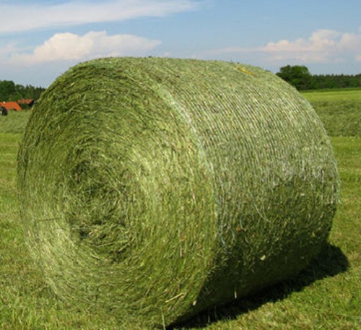
Round Bale
This is a large round bale of alfalfa. It also requires a tractor to move.

Slide 13
Small Square Bale
These are small square bales of alfalfa. Notice that the farmer can easily pick up the bale to move it. Horse owners love this size of bales because they are easy to transport and less cumbersome.

Slide 14
Lesson Exploration
Students will go outside to make observations and take measurements of the bales.
Students will be given a “toolkit” containing:
String
Scissors
Ruler
Yardstick
Tape measure
Paper & pencil
Calculator

Slide 15
Small Group Time
Compare measurements
Discuss what they need to find (surface area vs. volume)
Proceed to solve the problems on the handout.

Slide 16
Handout

Slide 17
Possible Solution Methods
Measure bales with string
Measure bales with measuring tape
Measure bales with yardstick or ruler
Stack round bales on end
Draw a picture
Bar diagram
Lookup formulas
Discover formulas
Make a table

Slide 19
Monitoring Chart
Solution Method | Who and What | Order
Measures with ruler or yardstick
Measures with measuring tape or string
Uses diameter instead of radius
Finds surface area
Stacks round bales on end
Stacks square bales in alternating directions
Stacks round bales on side, staggered?

Slide 20
Possible Misconceptions
Using the wrong formula (surface area instead of volume)
Using diameter instead of radius
Labeling incorrectly (in² rather than in³)
Miscalculations, particularly the volume of the first bale
Measurements that are not precise
Rounding to the nearest whole number rather than rounding up

Slide 21
Guiding Questions
How are diameter and radius different? Which one do you need now?
How are surface area and volume different? Which one do you need now?
Since you can’t buy part of a bale, how should you estimate?
What would happen if you arranged the bales differently?

Slide 22
Lesson Closure
What is the mathematical name for the shape of each bale?
How was the volume of each bale determined?
Did the arrangement of the bales in the barn affect the number of bales that fit?
Which bale was the best deal?

Slide 23
Lesson Assessment
Write a paragraph describing what you learned from this activity. Be sure to include:
any formulas used
which bale you think is the best deal and why
which bale you think fits best in the barn and why
how this problem relates to your life

Slide 24
Lesson Extension
Estimate how many bales of each type you can fit on a given semi trailer.
Given the density of the bale, calculate the weight of the load.
Determine if the semi can carry this load.
Research SD DoT laws and determine if your load is legal by both dimensions and weight.

